Slide 1

Title of the Project: Bank Loan Analytics
Project Supervisor : Dr.T. Prem Jacob Professor CSE
Name of the Students:G.Vishwanth,Vikraman
Register Number : 41111386, 41111371

Slide 2
Presentation Outline
Introduction
Objectives
SystemArchitecture / Ideation map
Application Snapshots
KPI’s Lists
Conclusion
References

Slide 3
Introduction
In today's dynamic financial landscape, banks are constantly seeking ways to optimize lending practices, minimize risks, and enhance customer experience. The ability to harness the power of data analytics has become paramount in achieving these objectives. This project aims to leverage Tableau, a leading business intelligence and data visualization platform, to delve into the realm of bank loan analytics.
Through a comprehensive analysis of loan data, we endeavor to uncover insights that will empower banks to make informed decisions, streamline processes, and ultimately drive profitability. By utilizing Tableau's intuitive interface and powerful visualization capabilities, we will explore key metrics, detect patterns, and identify trends within the loan portfolio.
From assessing credit risk and predicting default probabilities to optimizing loan approval processes and enhancing customer segmentation, the potential applications of bank loan analytics are vast and varied. With Tableau as our tool of choice, we embark on a journey to transform raw data into actionable insights, enabling banks to thrive in an increasingly competitive marketplace.
Join us as we navigate the intricate landscape of bank loan analytics, where data meets innovation to shape the future of lending.

Slide 4
Objectives
Objectives for bank loan analytics typically revolve around optimizing lending processes, managing risks, and enhancing profitability. Here are some common objectives:
Risk Assessment: Develop models to accurately assess the creditworthiness of loan applicants, reducing the risk of defaults and non-performing loans.
Fraud Detection: Implement algorithms and analytics to detect fraudulent loan applications and transactions, safeguarding the bank's assets and reputation.
Customer Segmentation: Analyze customer data to segment borrowers based on various criteria such as credit history, income levels, and risk profiles, allowing for targeted marketing and tailored loan products.

Slide 5
System Architecture/ Ideation Map
Data sources
Data storage
Data processing
Data Visualization and Reporting
Department of CSE

Slide 6
Project Implementation
1. Data Collection and Integration:
Identify and collect relevant bank loan data from various sources such as customer name ,loan amount,interst rate and due date data. Develop data integration processes to cleanse, standardize, and harmonize disparate data sources.
Ensure compliance with data privacy regulations (e.g., HIPAA) and implement appropriate security measures.
2. Analytics Model Development:
Identify appropriate analytics techniques and machine learning algorithms based on project objectives.
Develop predictive models for year wise loan amout ,state wise loan amount etc.
3. Dashboard and Report Development:
Design intuitive dashboards, reports, and visualizations to present insights derived from healthcare data.
Customize dashboards for different user groups to meet their specific needs.
Ensure interactive features and drill-down capabilities for deeper data exploration.

Slide 7
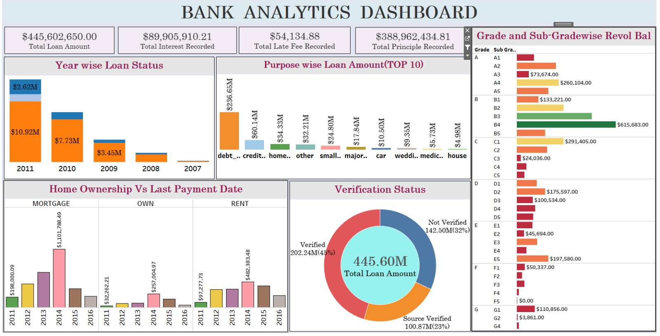
Sample Snapshot

Slide 8
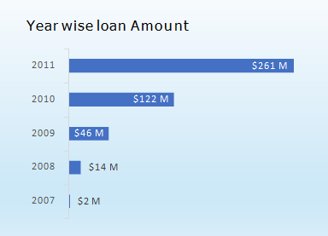
KPI-1 : Y E A R W I S E LOAN AMOUNT S T A T S
By observing this chart we can see how loan amount is increasing by year.
It is continuously increasing by each year as you see it‘s varies from 2M to 261M between the years 2007 to 2011.
From the year 2009, The changes in loan amount is suddenly increased with a higher rate that is around 5 times for next 2 years as compared to pervious years.

Slide 9
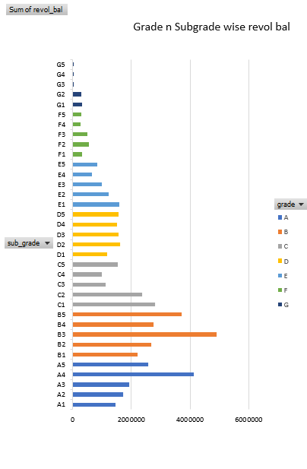
KPI-2 : G R A D E AND S U B G R A D E W I S E R E V O L_B A L
In this Grade and subgrade wise revol balance we can notice Grade B have more revol balance then any other grades & Grade G have very low revol balance.
The average revolving balance is higher in the ‘grade B’ its around 29M and the maximum reaches in the ‘sub-grade B1’ that is 39M, Same like the average lower revolving balance is in ‘grade G’ its around 1200K and the minimum reaches in the ‘sub-grade G5’ that is 701k.

Slide 10
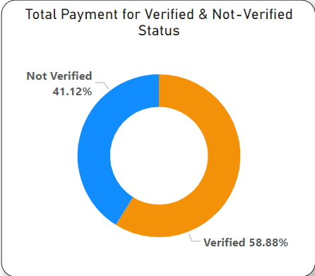
KPI-3 : T O T A L P A Y M E N T F O R V E R I F I E D VS NON V E R I F I E D S T A T U S
As we Can see in the Donut Chart that Out of $373 Million only 59% are verified i.e. $220million
41% of $373 Million are not verified i.e. $ 154 Million. aWhich might be a threat to company, Should inform the verification team to take required action regarding that.

Slide 11
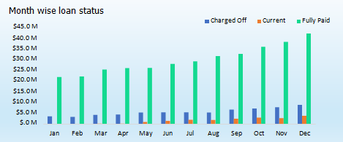
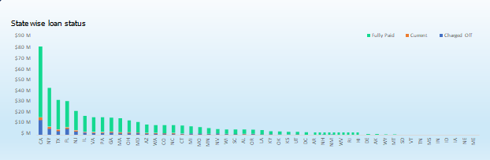
KPI-4 : S T A T E W I S E AND MONTH W I S E LOAN S T A T U S
In the data set we have different states and the months along with the 3 types of loan status.
In the state wise loan status we can observe that CA,NY,TX,FL & NJ are the top states to fully paid amount.
In the month wise loan status we can observe that Dec, Nov and oct are the fully paid amount

Slide 12
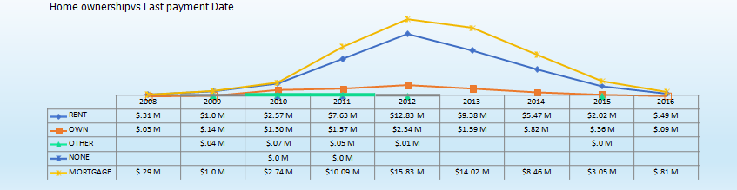
KPI 5:HOME O W N E R S H I P V S L A S T P A Y M E N T D A T E S T A T S
In this chart is shown by the types of home ownerships varies from 2008 to 2016.
In maximum amount reaches in the year 2012 who Rent and Mortgage house owners has paid their last Payment is 12 million and 15 million. And the minimum amount reaches in year 2008 and payment is 0.29 million and 0.31million.

Slide 13
Conclusion
Analyzing bank loan data provides valuable insights for decision-making and risk management. Through thorough examination of various parameters such as applicant demographics, credit history, loan amount, and purpose, banks can better understand their customer base and tailor their lending strategies accordingly.
By leveraging advanced analytics techniques such as machine learning algorithms, banks can predict creditworthiness more accurately, thereby reducing default rates and optimizing their loan portfolios. Additionally, analyzing historical loan performance data enables banks to identify trends, assess the effectiveness of their lending policies, and make informed adjustments as needed.
In conclusion, bank loan analytics not only enhances credit risk assessment but also improves operational efficiency and profitability for financial institutions. By harnessing the power of data-driven insights, banks can mitigate risks, seize opportunities, and better serve their customers in a rapidly evolving financial landscape.

Slide 14
References
Websites and Blogs:
Kaggle (www.kaggle.com): Kaggle offers datasets, competitions, and kernels (code notebooks) related to bank loan analytics.
Books:
"Financial Risk Management: Models, History, and Institutions" by Allan M. Malz
Research Papers:
Berger, A. N., & Udell, G. F. (1995). Relationship Lending and Lines of Credit in Small Firm Finance. Journal of Business, 68(3), 351–381.

Slide 15
THANK YOU

